Slide 1

1. What is runway safety area
The runway safety area is the cleared and graded area around the paved runway. It is kept free from any obstacles that might impede flight or ground roll of aircraft.
Runway safety area include the following six types:
1. Runway Shoulder
2. Runway Turn Pad
3. Clearway (CWY)
4. Stopway (SWY)
5. Runway Strip
6. Runway End Safety Areas(RESA)
Runway Shoulder 跑道道肩；Runway Turn Pad 跑道掉头坪
Clearway 净空道； Stopway 停止道；Runway Strip升降带
Runway End Safety Areas 跑道端安全地区

Slide 2
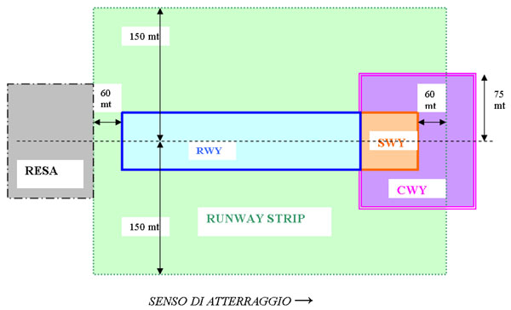
1. What is runway safety area
runway safety area distribution

Slide 3
2. Runway Accidents
Generally, runway accidents include the following three types:
Runway excursion
Runway incursion
Runway confusion
Runway excursion 偏出跑道
Runway incursion 跑道入侵
Runway confusion 落错跑道
总参考网站：
http://www.doc88.com/p-125263517445.html

Slide 4
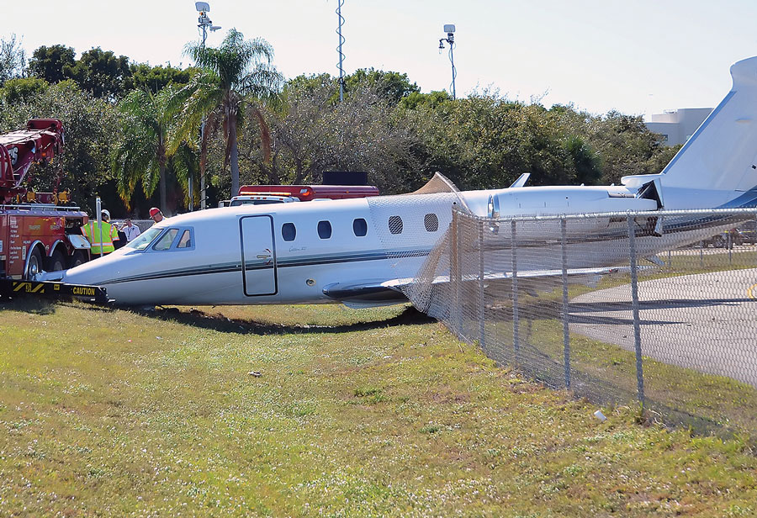
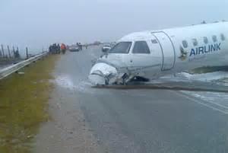
2. Runway Accidents
Runway excursion
Runway excursion is an incident involving only a single aircraft, where it makes an inappropriate exit from the runway. This can happen because of pilot error, poor weather, or a fault with the aircraft.
Runway excursion 偏出跑道

Slide 5
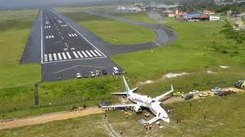
2. Runway Accidents
Runway excursion
Overrun is a type of excursion where the aircraft is unable to stop before the end of the runway.
Runway excursion 偏出跑道

Slide 6
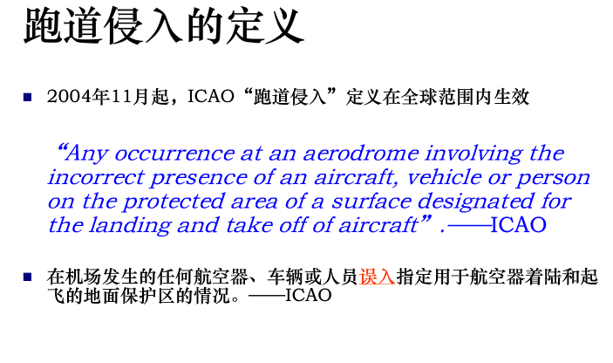
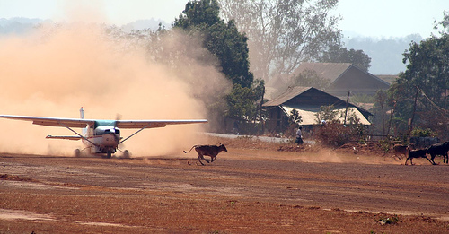
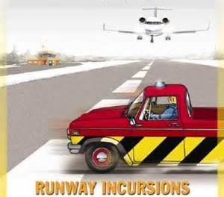
2. Runway Accidents
Runway incursion
Runway incursion involves a first aircraft, as well as a second aircraft, vehicle, or person, etc. It is defined by both the U.S. FAA and ICAO as "Any occurrence at an airport involving the incorrect presence of an aircraft, vehicle or person on the protected area of a surface designated for the landing and take off of aircraft."
Runway incursion 跑道入侵

Slide 7
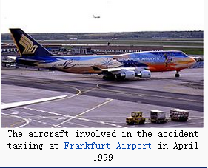
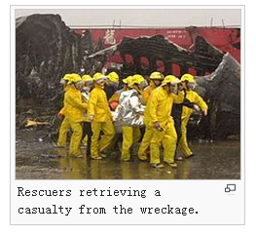
2. Runway Accidents
Runway confusion
Runway confusion involves a single aircraft, and is used to describe the error when the aircraft makes "the unintentional use of the wrong runway, or a taxiway, for landing or take-off".
A notable example of a runway confusion incident is Singapore Airlines Flight 006
Runway confusion 落错跑道
https://en.wikipedia.org/wiki/Singapore_Airlines_Flight_006

Slide 8


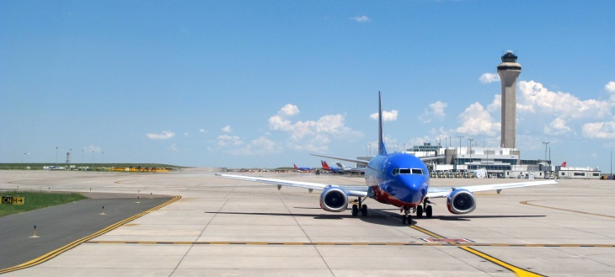
4. Runway Turn Pad
Question:
How can a plane accomplish a 180-degree turn on a runway?

Slide 9
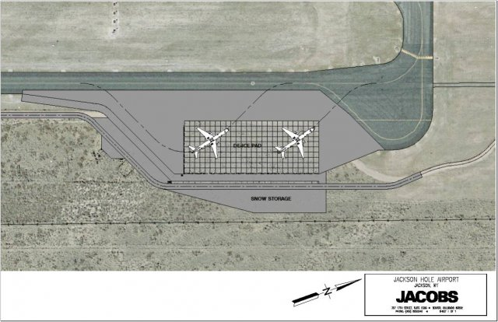
4. Runway Turn Pad
A defined area on a land aerodrome adjacent to a runway for the purpose of completing a 180-degree turn on a runway.
Runway Turn Pad 跑道掉头坪

